Slide 1
REAL TIME ENERGY MONITERING SYSTEM INCORPORATED WITH AUTOMATED FUNCTIONS

Slide 2
ABSTRACT
An energy meter is an electrical device that measures the electrical energy being consumed over time, but now, in modern world this out dated to execute, there comes the IoT(Internet of Things) enabled Energy meter , that monitor units consumed and transmit the cost and units through Wi-Fi, Since time goes on and technology grows we, our team have tried to incorporate the essence of Automation into the existing tech IoT, we hope will upgrade the normal smart energy meter to a super smart one. To be clear, our end result will supervise the monitored units and cost by smart meter by an added circuit driven by custom firmware which will cut-off the non-essential loads running, and minimize the energy usage, will also keep the daily energy cost under the culmination value set by the user, also the user will have the full control over the system through a mobile app powered by IoT.

Slide 3
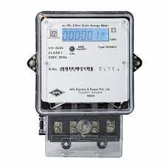
DIGITAL METER
The number of hours in a year is 365 times 24 = 8760 hours. Then on average, at any one time, your house is using 10,715 divided by 8760 hours, which is 1.22 units. The energy needs of a house at any instant then is on average 1.22 units.
The average Indian consumers end up paying a shade over Rs 8 for every unit of power consumed and their monthly average bill is around Rs 6,500," said an energy analyst.

Slide 4
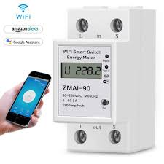
IOT METER
Major IoT applications for energy monitoring and management promise from 30% to up to 70% energy saving depending on the scale and functionality.
According to a study by DHL, they predict that the IoT will save businesses $1.2 trillion in productivity costs alone.

Slide 5
BLOCK DIAGRAM
DIGITAL ENERGY METER
MICRO CONTROLLER
GSM
LOAD
USER
CONTROL
MOBILE APP

Slide 6
PROJECT OUTCOME
ENERGY SAVING
ENERGY COST SAVING
REDUCE MANPOWER REQUIREMENT
SUSTAINBLE DEVELOPMENT
SIMPLE AND FLEXIBILITY
AUTOMATION IN ENERGYB MANAGEMENT

